Slide 1
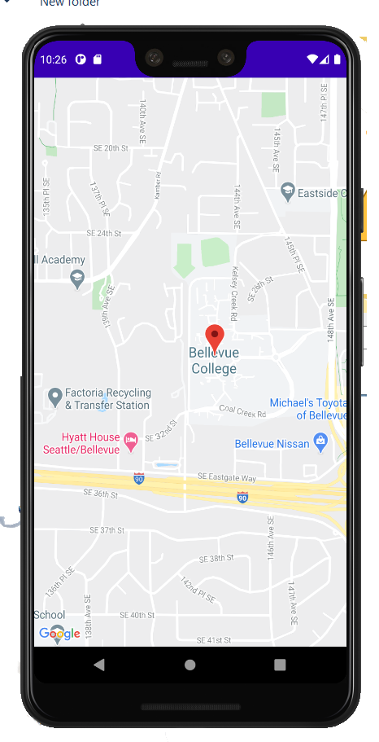
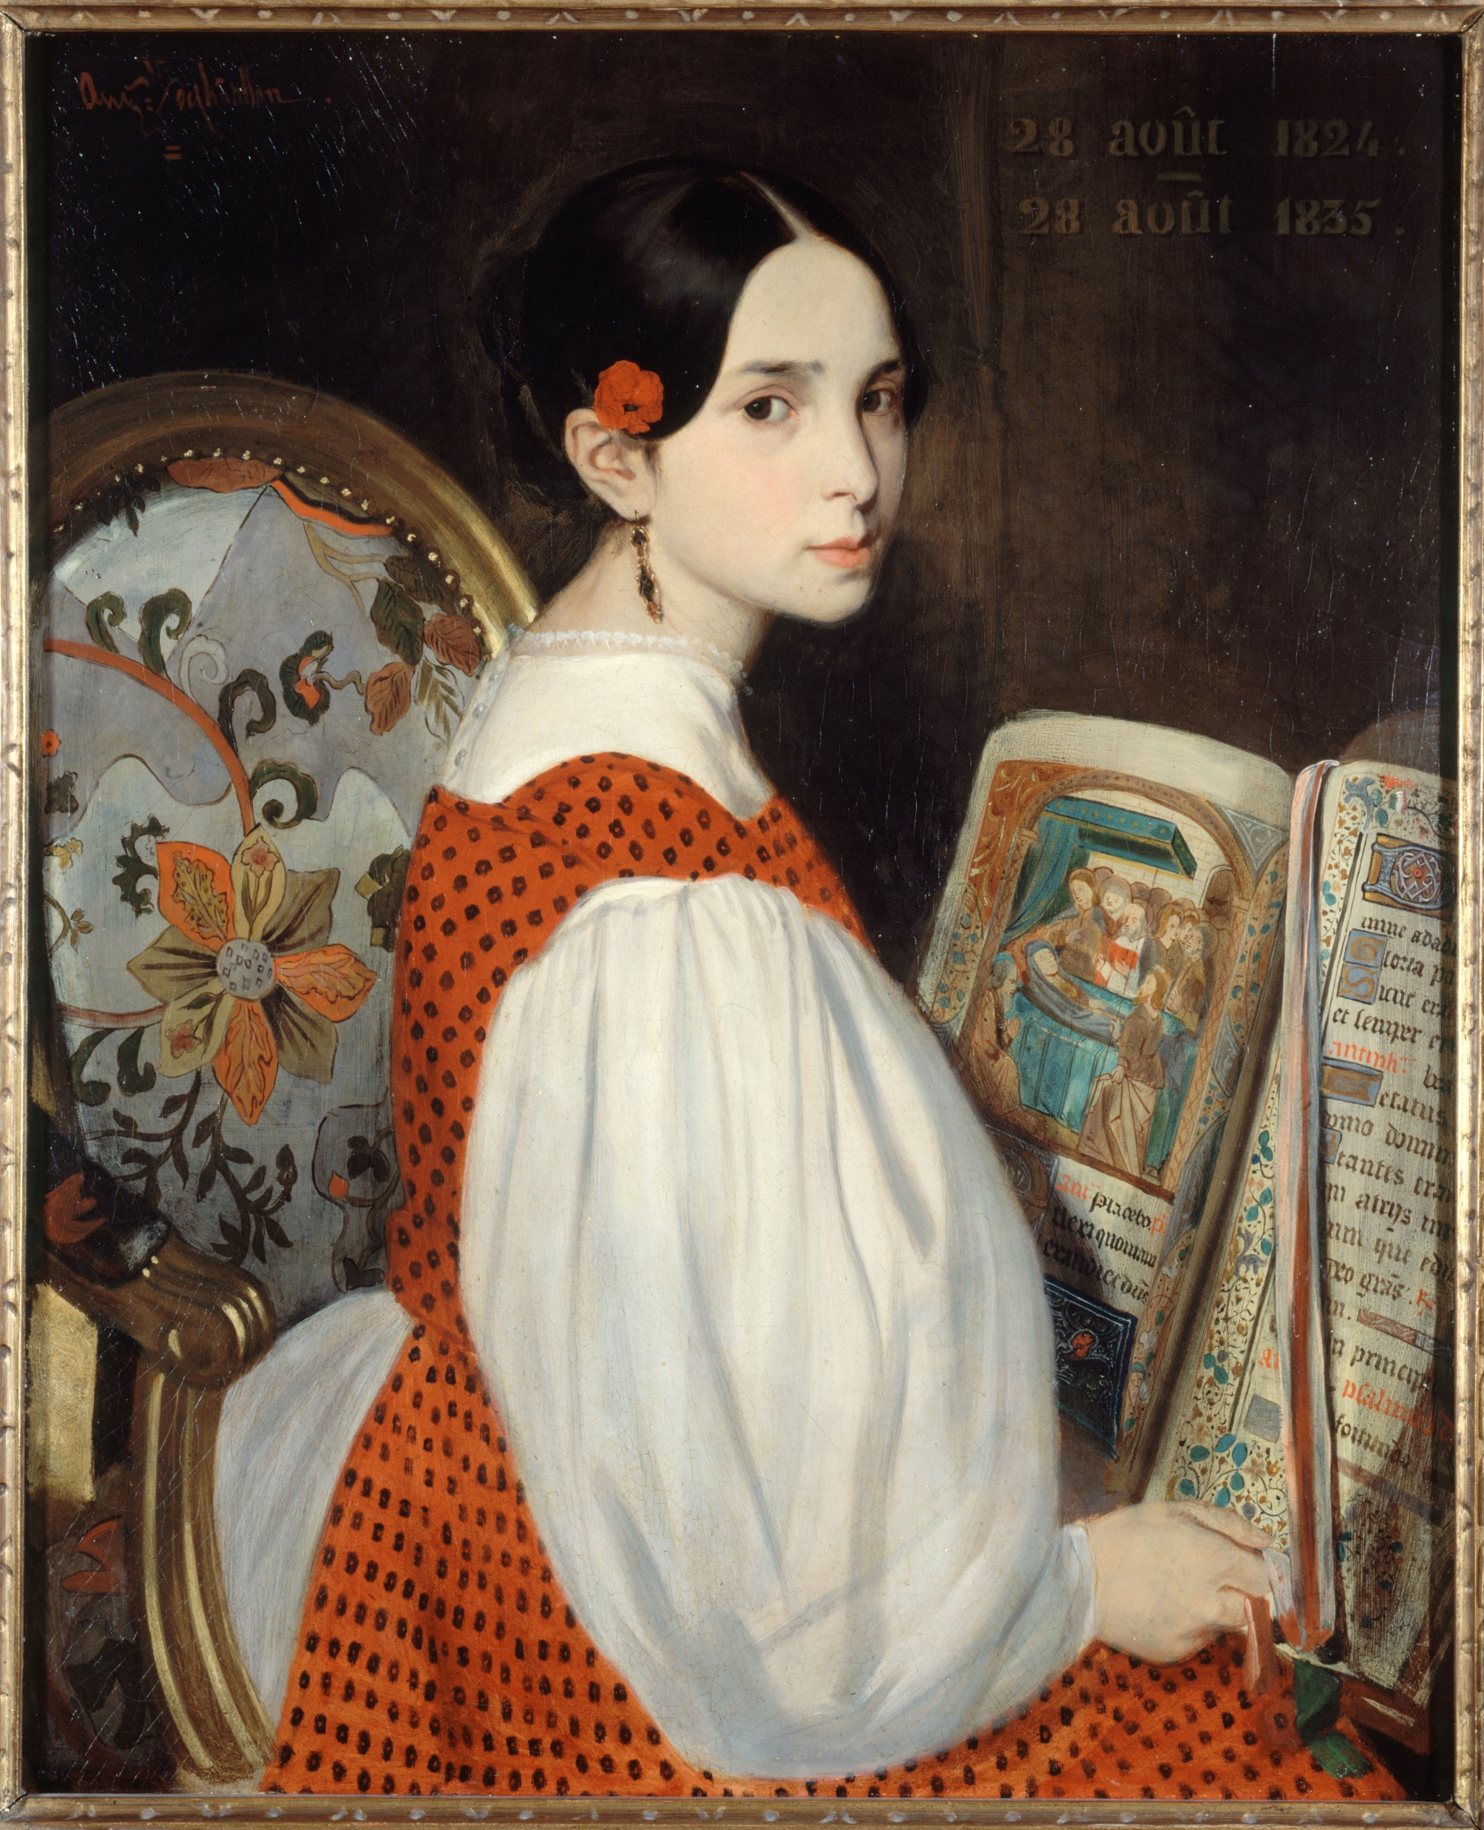
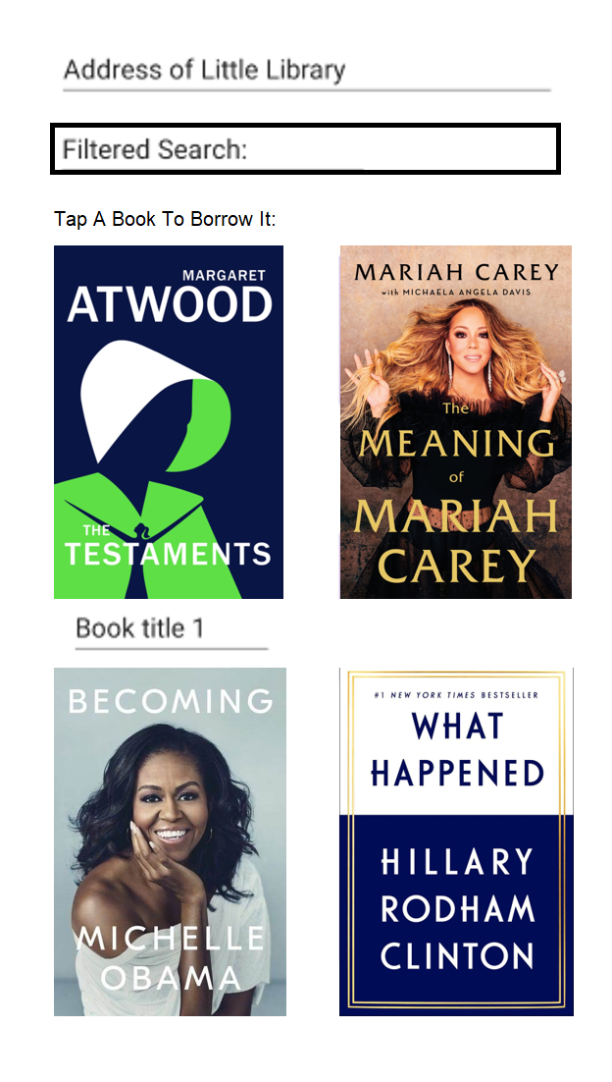
View Libraries
Search for Book
Login/Register
Libraworks Virtual Library

Slide 2
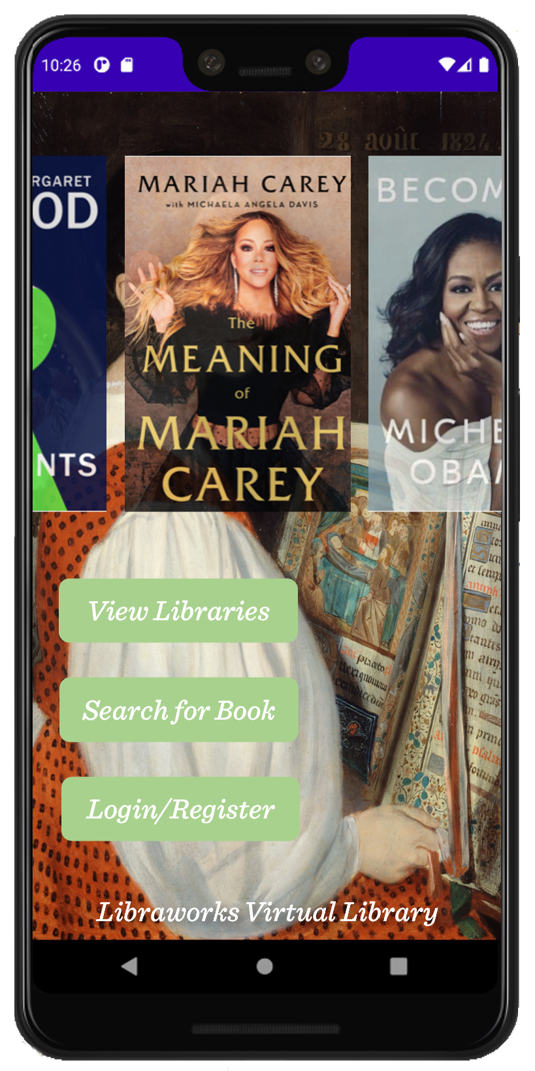

Slide 3
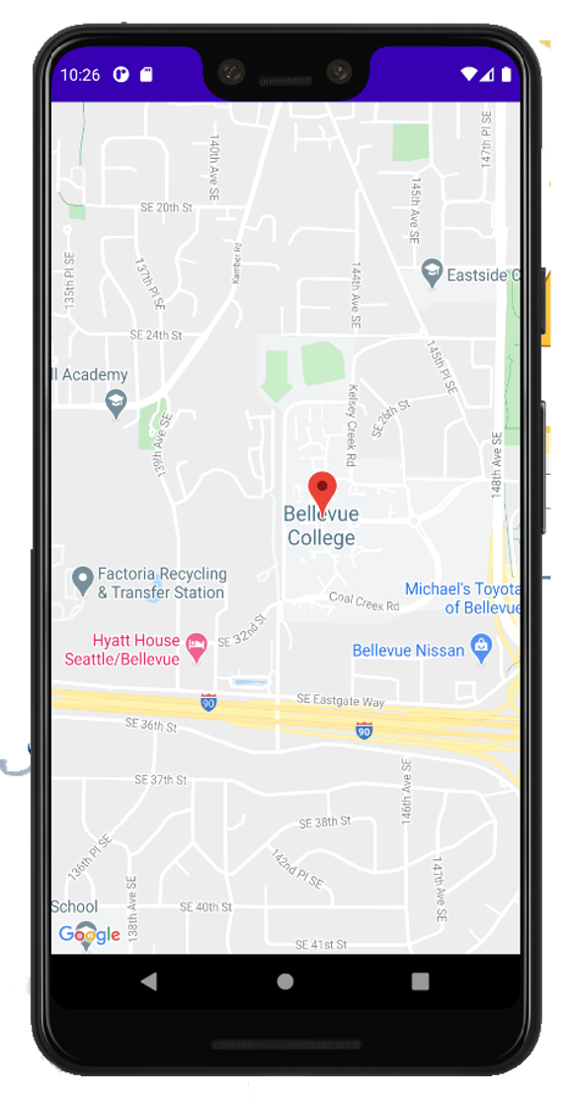
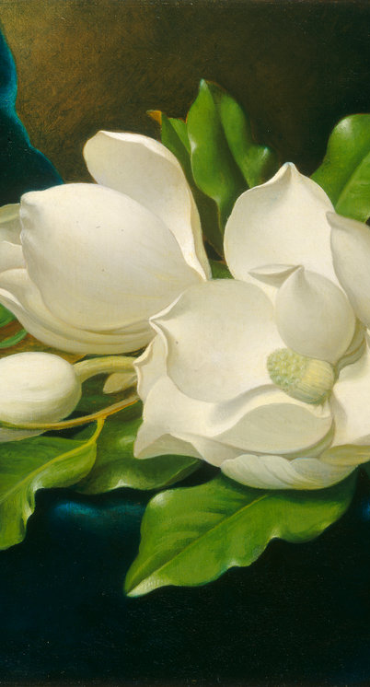





Anthony’s Little Library
Anthony’s Little Library
Filtered Search:
Harry P____________________
Harry Potter and the Sorcerer’s Stone
_________________________
Harry Potter and the Deathly Hallows

Slide 4
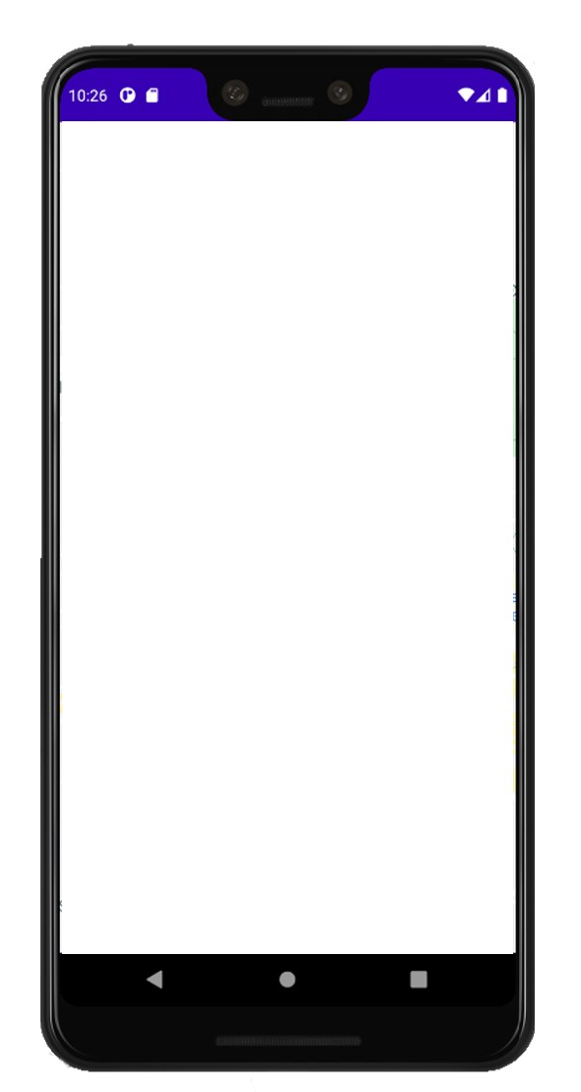

Virtual Library
_____________________
LibraWorks Inc
User Login _______________
Email___________________
***********_______________
Remember me
LOGIN
Not a user?
REGISTER

